Slide 1
Matt Bullock, P.E. Chief District Engineer Kentucky Transportation Cabinet

Slide 2
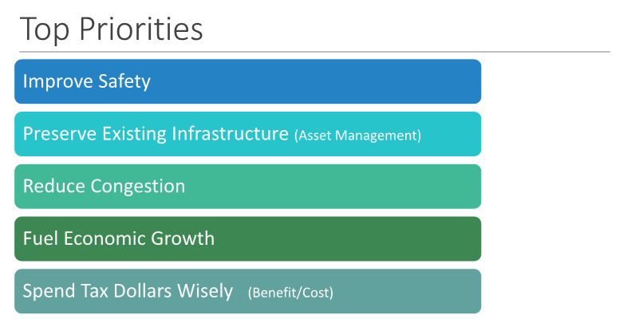

Slide 4
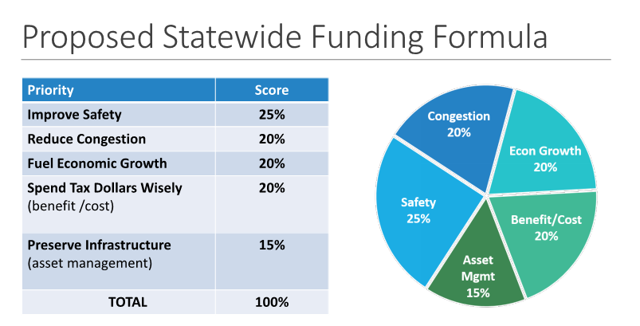

Slide 5
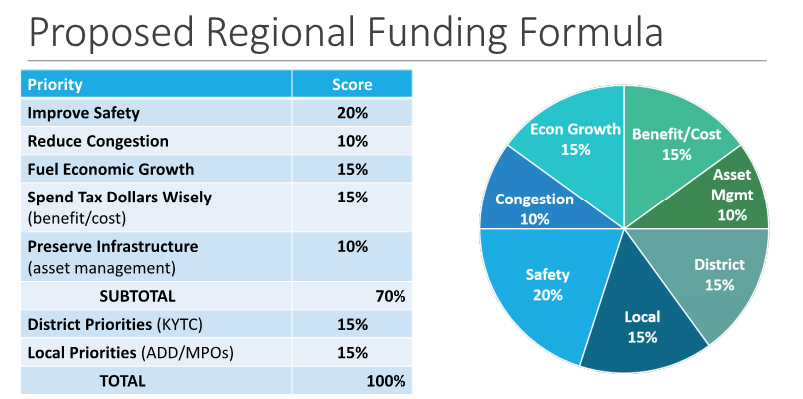

Slide 6
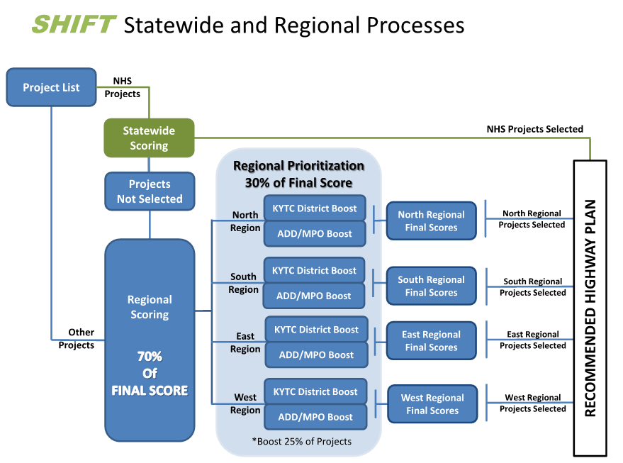

Slide 7
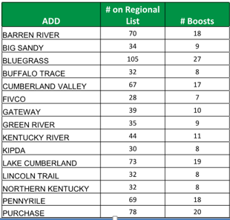
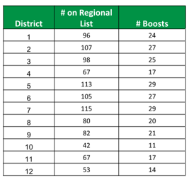
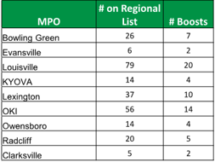

Slide 8
2017 SHIFT: Guiding Principles (Criteria) for Qualitative Prioritization of Projects
Project has previous investment into the design, right-of-way and/or utility phases
Project is ready for construction
Project is in the STIP / TIP
Project is a segment in a larger corridor project; completes a corridor improvement (Continuity)
Project is in a local or regional comprehensive plan
Public Interest
Safety (e.g. safety issues not fully captured by police reports)
Congestion
Multi-District Need
Economic Development
Public Infrastructure (e.g. schools, universities, parks, airports)

Slide 12
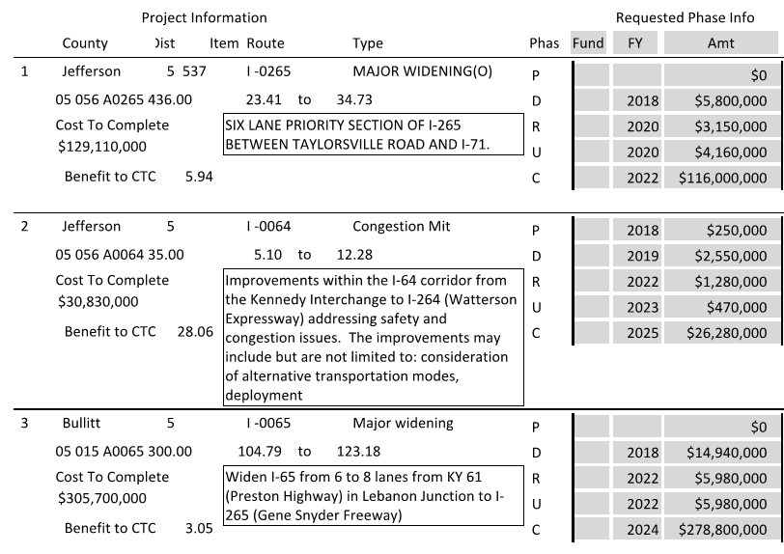

Slide 13
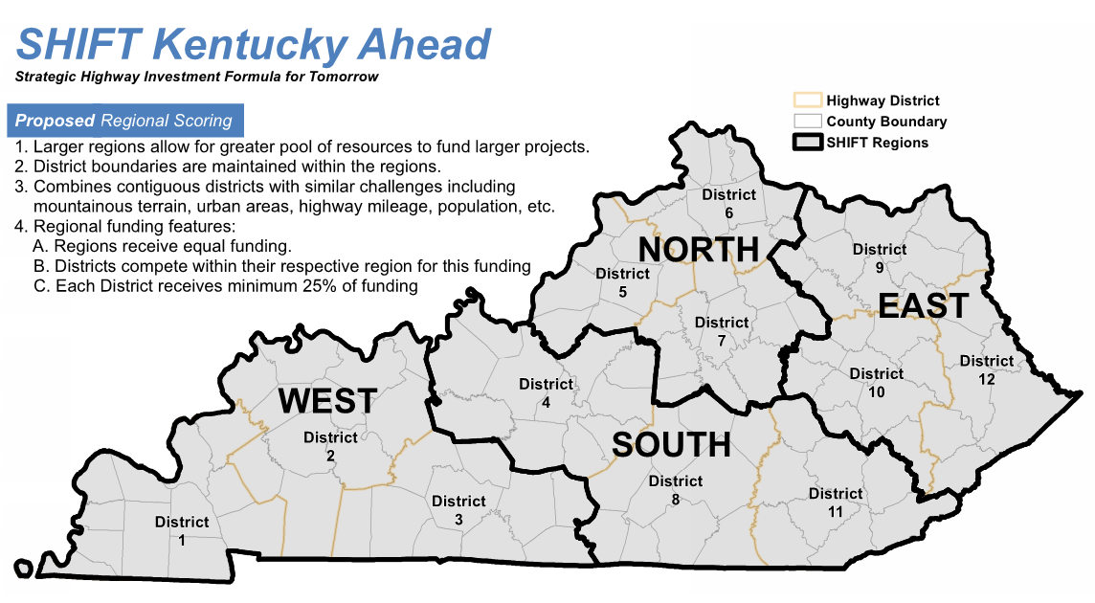

Slide 14
